Slide 1
Notes:
If this activity is working, you should see two circles and a square. Do you see the shapes?

Slide 2
Notes:
This is Jack. Jack has some questions. He’s not sure what the answers are, so he decides to ask other people for help.

Slide 3
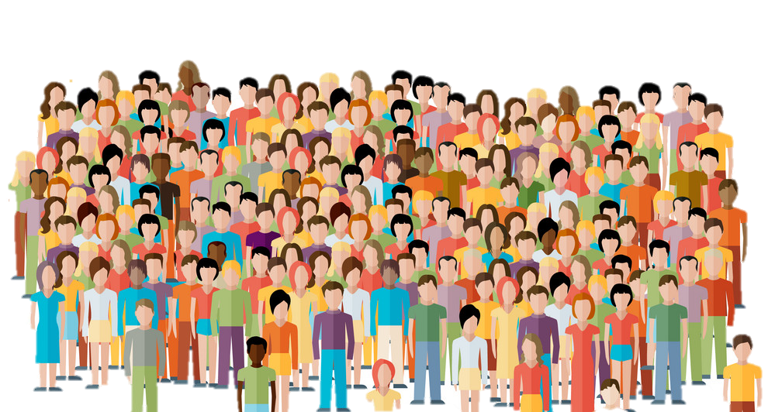
Notes:
Here are the people Jack can ask for help. But there are two ways he can ask for help.

Slide 4








Notes:
One way the people can help Jack is by Talking Together. Jack will ask 5 OF THE PEOPLE to answer the question by TALKING TOGETHER. Each person might think of a different answer AT FIRST, but THEN, all 5 people talk about the question TOGETHER. This way, they decide AS A GROUP WHAT THEY THINK the RIGHT answer is. Then, the group tells Jack the answer it thinks is right.

Slide 5

Notes:
The other way the people can help Jack is by Answering Alone. Jack will ask 50 OF THE PEOPLE to EACH answer the question ON THEIR OWN. Each person might think of a different answer, but they do NOT talk to each other about the question. Each person thinks about the question ON THEIR OWN. This way, EACH PERSON decides WHAT THEY THINK the RIGHT answer is. Then, EACH PERSON tells Jack the answer they think is right.

Slide 6
Notes:
So, you’ll see some of Jack’s questions. Your job is to decide which way of answering will help Jack more: FIVE people Talking Together, so BLUE, or FIFTY people Answering Alone, so GREEN.

Slide 7
LOADING SCREEN
Notes:
[LOADING SCREEN]

Slide 8
NIM
Notes:
Jack is playing a game called “pick up the pencils” against a super-smart computer. Each side takes turns picking up pencils. Each turn, you have to pick up either one, two, or three pencils. The WINNER is the person who picks up the LAST pencil!
[]
Now, there are five pencils left in this game. If Jack doesn’t make the right move, he’ll lose the game to the super-smart computer. So Jack wants to know: should he pick up 1 pencil, 2 pencils, or 3 pencils?
[]
So that was Jack’s question.
[]
But which answer will be more helpful? 5 people Talking Together, so BLUE, or 50 people Answering Alone, so GREEN?
[]
And do you think that answer is PROBABLY more helpful, or DEFINITELY more helpful?
[]
Okay!
[]
[Now let’s see the next question!]

Slide 9
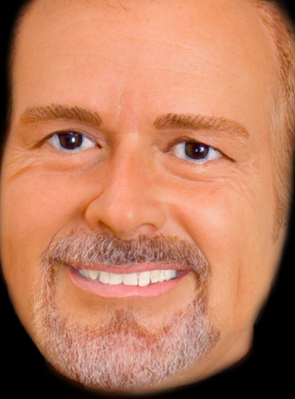




PHOTOREALISM
Notes:
Jack needs to decide which one of these pictures of his teacher is a drawing and which one is a photo. Jack’s friend Alex made the drawing by looking at the photo. Alex is an artist, so he made a great drawing! In fact, Alex’s drawing is so good that Jack isn’t sure which one is the photo and which one is the drawing. So, Jack wants to know: which one of these pictures is the drawing and which is the photograph?
[]
[]
So that was Jack’s question.
[]
But which answer will be more helpful? 5 people Talking Together, so BLUE, or 50 people Answering Alone, so GREEN?
[]
And do you think that answer is PROBABLY more helpful, or DEFINITELY more helpful?
[]
Okay!
[]
[Now let’s see the next question!]

Slide 10


SUDOKU 1
Notes:
Jack is planting a garden with blueberries, strawberries, lemons, and apples. He wants to plant his garden in a special way. He does NOT want two of the same kind of fruit in the same ROW [SLIDE], OR two of the same kind of fruit in the same SECTION [SLIDE]. Jack has already planted some fruit [SLIDE], but now he doesn’t know where to plant the rest of the fruit, so that there’s not two kinds in the same row OR two kinds in the same section. So Jack wanted to know: where should he plant the rest of his fruit?
[]
[]
So that was Jack’s question.
[]
But which answer will be more helpful? 5 people Talking Together, so BLUE, or 50 people Answering Alone, so GREEN?
[]
And do you think that answer is PROBABLY more helpful, or DEFINITELY more helpful?
[]
Okay!
[]
[Now let’s see the next question!]

Slide 11
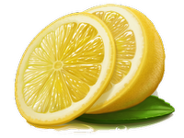
Notes:
Jack is planting a garden with blueberries, strawberries, lemons, and apples. He wants to plant his garden in a special way. He does NOT want two of the same kind of fruit in the same ROW [SLIDE], OR two of the same kind of fruit in the same SECTION [SLIDE]. Jack has already planted some fruit [SLIDE], but now he doesn’t know where to plant the rest of the fruit, so that there’s not two kinds in the same row OR two kinds in the same section. So Jack wanted to know: where should he plant the rest of his fruit?
[]
[]
So that was Jack’s question.
[]
But which answer will be more helpful? 5 people Talking Together, so BLUE, or 50 people Answering Alone, so GREEN?
[]
And do you think that answer is PROBABLY more helpful, or DEFINITELY more helpful?
[]
Okay!
[]
[Now let’s see the next question!]

Slide 12
Notes:
Jack is planting a garden with blueberries, strawberries, lemons, and apples. He wants to plant his garden in a special way. He does NOT want two of the same kind of fruit in the same ROW [SLIDE], OR two of the same kind of fruit in the same SECTION [SLIDE]. Jack has already planted some fruit [SLIDE], but now he doesn’t know where to plant the rest of the fruit, so that there’s not two kinds in the same row OR two kinds in the same section. So Jack wanted to know: where should he plant the rest of his fruit?
[]
[]
So that was Jack’s question.
[]
But which answer will be more helpful? 5 people Talking Together, so BLUE, or 50 people Answering Alone, so GREEN?
[]
And do you think that answer is PROBABLY more helpful, or DEFINITELY more helpful?
[]
Okay!
[]
[Now let’s see the next question!]

Slide 13
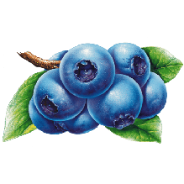
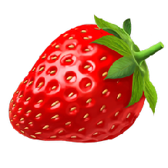
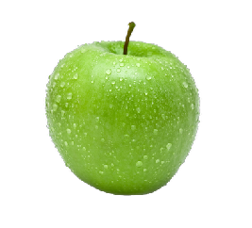
SUDOKU_Q
Notes:
Jack is planting a garden with blueberries, strawberries, lemons, and apples. He wants to plant his garden in a special way. He does NOT want two of the same kind of fruit in the same ROW [SLIDE], OR two of the same kind of fruit in the same SECTION [SLIDE]. Jack has already planted some fruit [SLIDE], but now he doesn’t know where to plant the rest of the fruit, so that there’s not two kinds in the same row OR two kinds in the same section. So Jack wanted to know: where should he plant the rest of his fruit?
[]
[]
So that was Jack’s question.
[]
But which answer will be more helpful? 5 people Talking Together, so BLUE, or 50 people Answering Alone, so GREEN?
[]
And do you think that answer is PROBABLY more helpful, or DEFINITELY more helpful?
[]
Okay!
[]
[Now let’s see the next question!]

Slide 14

SUPERBALLS
Notes:
There are some superballs in this box. Jack knows there are either 30 superballs in the box, or 40 superballs in the box. Jack can win a prize if he can say how many there are, but he’s not allowed to open the box. He can only shake the box and listen to the balls bounce. This is what it sounded like [PLAY]. Could you hear the balls bounce? So, Jack listened to the balls bounce, and then he had to say: how many superballs are in the box: 30, or 40?
[]
[]
So that was Jack’s question.
[]
But which answer will be more helpful? 5 people Talking Together, so BLUE, or 50 people Answering Alone, so GREEN?
[]
And do you think that answer is PROBABLY more helpful, or DEFINITELY more helpful?
[]
Okay!
[]
[Now let’s see the next question!]

Slide 15
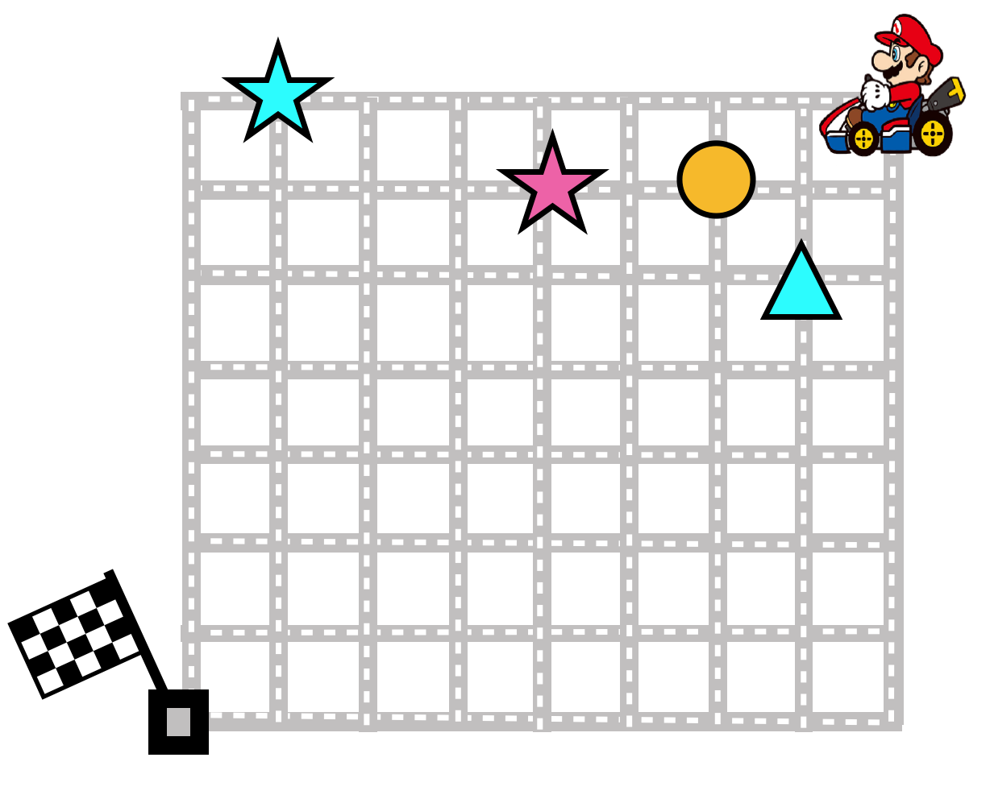
MARIO
Notes:
Jack has Mario in a race. He wants Mario to collect all of these treasures. But, there’s a rule. He can NOT collect two in a row that are the same color or two in a row that are the same shape. But Jack wants Mario to collect all of the treasures on the map as fast as possible. So Jack wanted to know: what is the SHORTEST way for Mario to drive through map?
[]
[]
So that was Jack’s question.
[]
But which answer will be more helpful? 5 people Talking Together, so BLUE, or 50 people Answering Alone, so GREEN?
[]
And do you think that answer is PROBABLY more helpful, or DEFINITELY more helpful?
[]
Okay!
[]
[Now let’s see the next question!]

Slide 16
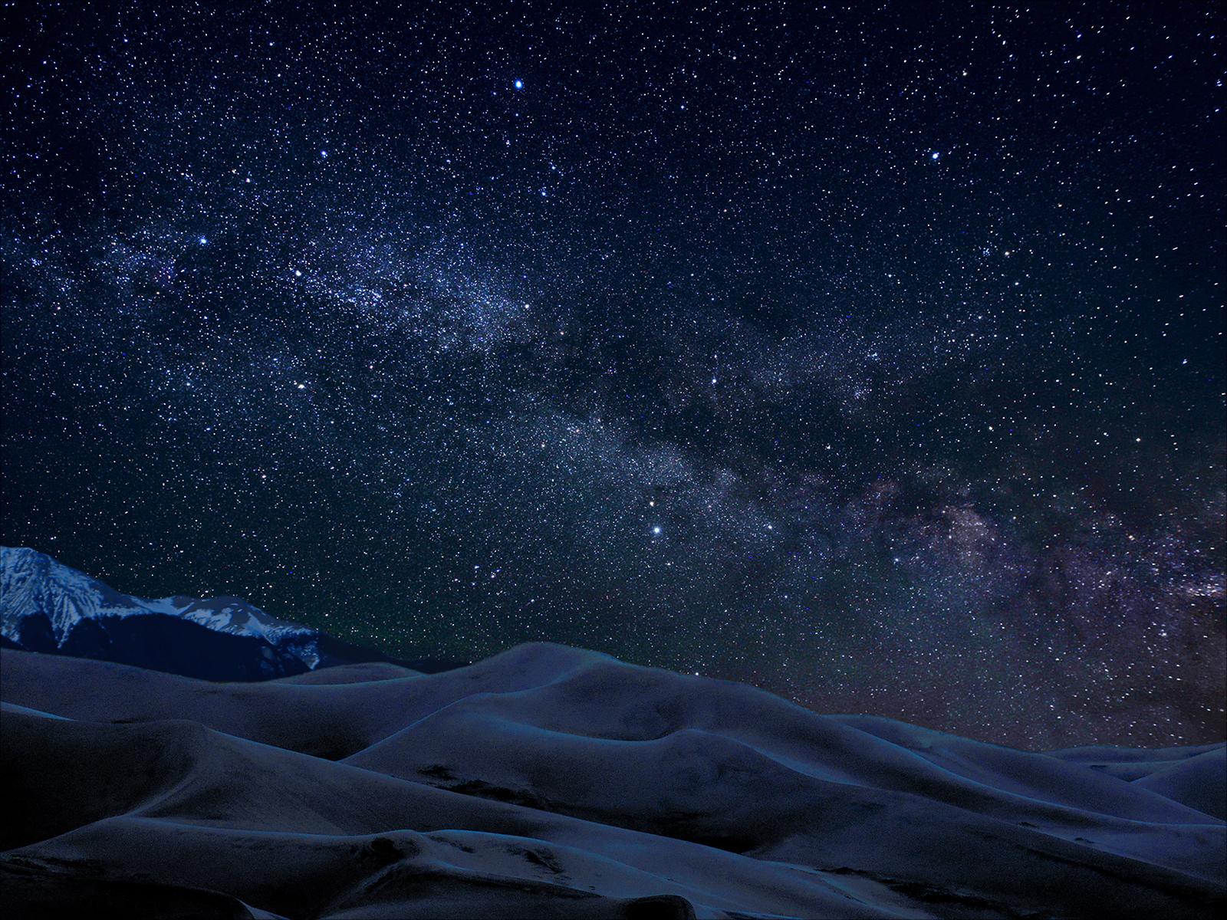
STARS
Notes:
Jack and his school went on a camping trip. At night, they could see the stars very clearly — they looked like they do in this picture. But Jack wanted to know which stars that night are the brightest: which star is FIRST brightest, which star is SECOND brightest — up to the TWENTY-FIVE brightest stars. So, Jack took a picture so that he could circle the brightest ones. But he wasn’t sure about some of them. So Jack wants to know: what were the brightest stars in his picture, from first to twenty-fifth?
[]
[]
So that was Jack’s question.
[]
But which answer will be more helpful? 5 people Talking Together, so BLUE, or 50 people Answering Alone, so GREEN?
[]
And do you think that answer is PROBABLY more helpful, or DEFINITELY more helpful?
[]
Okay!
[]
[Now let’s see the next question!]

Slide 17
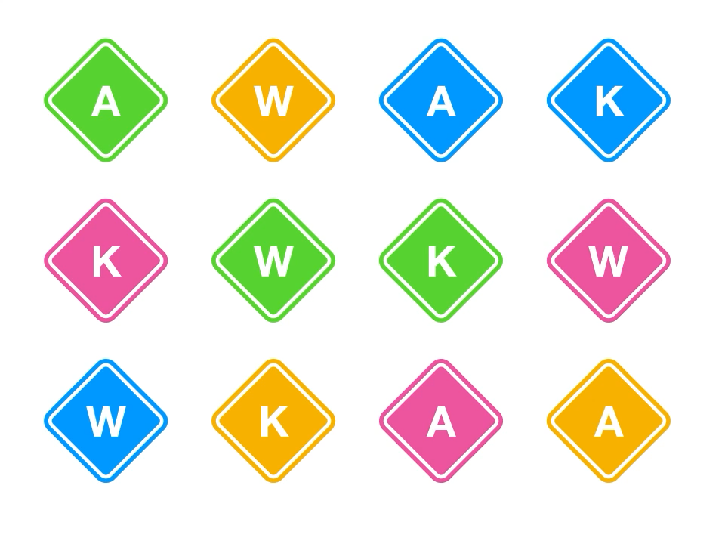
SPIN
Notes:
Jack is playing a game with these colored letters. He needs to choose the one that’s spinning around the fastest. Each one is different: they’re either green, blue, pink, or yellow, and they have either an A, a K, or a W on them. Jack gets to watch them all spin around at the same time, and then he has to say WHICH ONE was spinning the FASTEST. This is what they looked like [PLAY]. Could you see them spin? So, Jack watched the colored letters spin, and then he wanted to know: which one was spinning the FASTEST?
[]
[]
So that was Jack’s question.
[]
But which answer will be more helpful? 5 people Talking Together, so BLUE, or 50 people Answering Alone, so GREEN?
[]
And do you think that answer is PROBABLY more helpful, or DEFINITELY more helpful?
[]
Okay!
[]
[Now let’s see the next question!]

Slide 18
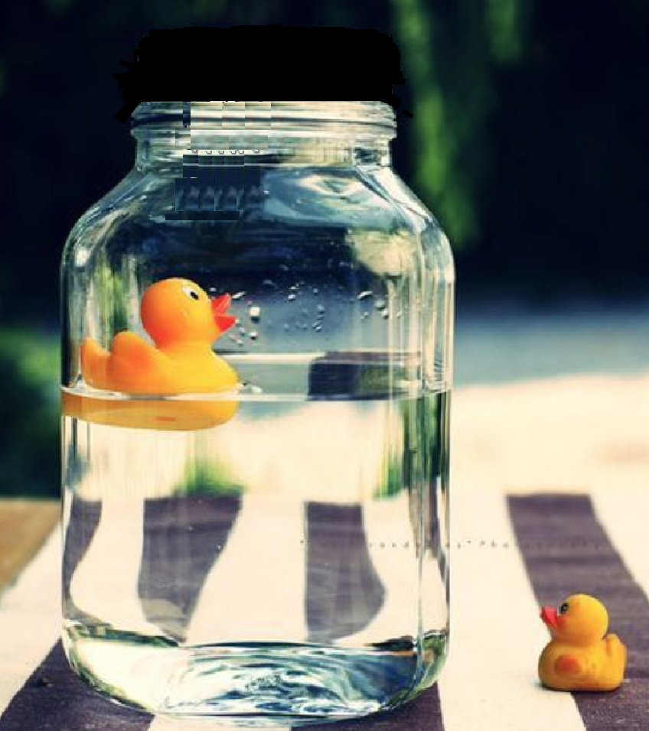
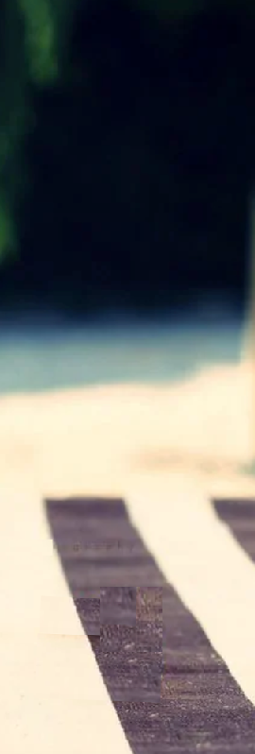
Reas_Bottle
BOTTLE
Notes:
One of these jars has a rubber ducky floating in it. Jack wants to get the rubber ducky out of the jar. But, he’s not allowed to touch the rubber ducky OR the jar it’s in. He can only touch the other jar — the one that has water in it, but no rubber ducky. So Jack wants to know: how can he get the rubber ducky out of the jar without touching the ducky or the jar it’s in?
[]
[]
So that was Jack’s question.
[]
But which answer will be more helpful? 5 people Talking Together, so BLUE, or 50 people Answering Alone, so GREEN?
[]
And do you think that answer is PROBABLY more helpful, or DEFINITELY more helpful?
[]
Okay!
[]
[Now let’s see the next question!]

Slide 19
END
Notes:
[LOADING SCREEN]

